Slide 1
Applied Project 21 April 2023

Slide 2
1.1 Problem Last time…
Deepcopy creates a complete copy of an object in memory.
Deepcopy also eats more resource than handcrafted copying function.
On searching more, If an object contains a circular reference, such as an object that refers to itself, deep copying can result in an infinite loop, which can cause your program to crash or run out of memory.
Deepcopy is not advisable to use when you are using objects referring to data dictionaries.
All red flags!

Slide 3
1.2 Handcrafted Deepcopy
def copy_individual(self):
copied_individual = Individual()
copied_individual.genes = np.copy(self.genes)
copied_individual.fitness = self.fitness
copied_individual.saved_dir = self.saved_dir
return copied_individual

Slide 4
1.3 Not sure this is the only problem…
But at least for now code is working fine for 500 gens
Problem with file saving methodology is that we need to completely restructure the code. We tried debugging but it did not work as FunAnimation runs the driving code and it is directly imported from maplotlib.

Slide 5
2.1 System Configuration
64GB RAM
250 GB hard drive
8 vCPU
AWS ml.r5.2large
Each parallel instance has this configuration

Slide 6
2.2 Duration of run
It takes almost ~24 hours to finish one run of 500 generations with this configuration.
Once cloud limit is increased, we will run 21 experiments as planned (experimental setup in upcoming slides) on 21 different instances parallelly.
However, it is tested for 3 times by running 500 generations.

Slide 7
3.1 Fixed Hyperparameters – Dataset Related
Dataset_size = 30 animations * 100 frames = 3000 frames
DPI = 50
Mu = 0.31 (Growth Function)
Sigma= 0.057 (Growth Function)
Dt = 0.1
Fps=30 (for animation saving purpose)
Kernel Size = 16
Board Size = 64

Slide 8
3.2 Fixed Hyperparameters – Autoencoder Related
Image Size = (28,28)
AE test size = 0.3
AE Input Size = 784
AE Hidden Size = 36
AE Input Size = 784
Epochs = 300
Batch_size = 128

Slide 9
3.3 Fixed Hyperparameters – EC Related
Kernel size = 16
Board size = 64
Mutation rate = 0.02
Population size = 10
Generation = 500
Elites = 1

Slide 10
4.1 Theory for AEVoT
So the reidea is to maximize the deviation of reconstruction. The more the pixels are deviated over time in a reconstructed animation (so let say we have 100 frames of original rule set. those 100 frames vs same frames reconstructed through Autoencoder. The hypothesis is, if we have deviation in cumulative re-construction loss of those 100 frames, that means there should be some non-boring behavior)
If the autoencoder is successful in reconstructing the input data accurately, then the reconstruction error will be low. However, if the input data is complex and has a lot of variability, it may be difficult for the autoencoder to reconstruct the data accurately, resulting in a higher reconstruction error.

Slide 11
4.2 Experimental theory for AEVoT
Therefore, the reconstruction error can be used as a measure of complexity, where higher reconstruction error indicates higher complexity. This is because complex data is more difficult to accurately represent and reconstruct using a compressed representation.

Slide 12
4.3 How VoT can be used in AE? And What is the theoretical significance?
By analyzing the variation in the reconstruction loss over time, we can gain insights into the complexity of the time series Lenia sim. For example, if the reconstruction loss is relatively constant over time, it may indicate that the time series Lenia sim is relatively simple or predictable. However, if the reconstruction loss varies widely over time, it may indicate that the time series Lenia sim is more complex and difficult to predict.

Slide 13
4.4 Cumulative vs STD
Cumulative works in AE
Std works in VoT

Slide 14
4.5 Fitness working
Creates an instance of "LeniaForGA" class
The method loops through the "board_framess" values, and for each value, it reconstructs a board from it and calculates the error between the original board and the reconstructed one.
For each reconstructed board, the method counts the number of alive cells and appends the counts to a list. It then selects every 10th value starting from the 10th index of thelist and stores them in a new list.
Finally, the method calculates the population standard deviation of new list

Slide 15
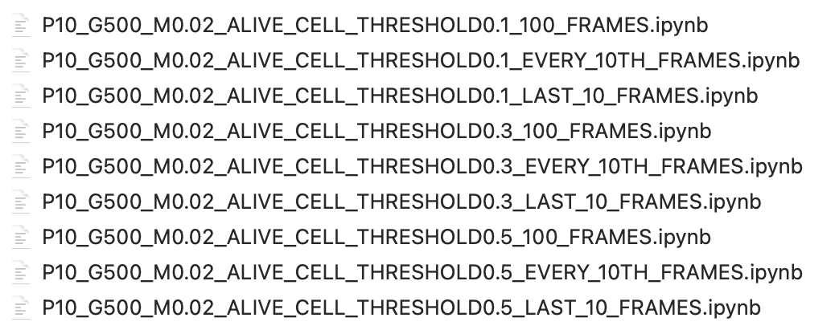
5.1 Experimental Setup
Performing 1st class of experiments:
Only VoT, with varying active cell thresh and frames

Slide 16
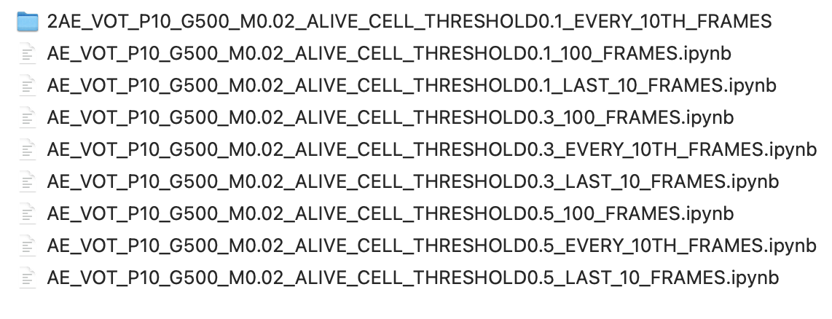
5.2 Experimental Setup
Performing 2nd class of experiments:
Only AEVoT, with varying active cell thresh and frames

Slide 17
5.3 Experimental Setup
Performing 3rd class of experiments:
Using only AE
7 experiments needed to be done once AEVoT and VoT are done.

Slide 18
5.4 What are varying?
Whole 100 frames fitness
Last 10 frames fitness
Every 10th frame fitness
Alive cell threshold 0.1, 0.3 and 0.5
AEVoT uses cumulative + Deviation based fitness
VoT uses Deviation based fitness
AE uses cumulative based fitness (cumulative errros)

Slide 19
5.5 Experimentation so far
6 x 100 gen experiments
4 x 200 gen experiments
2 x 500 gen experiments
2AE_VOT_P10_G500_M0.02_ALIVE_CELL_THRESHOLD0.1_EVERY_10TH_FRAMES

Slide 20
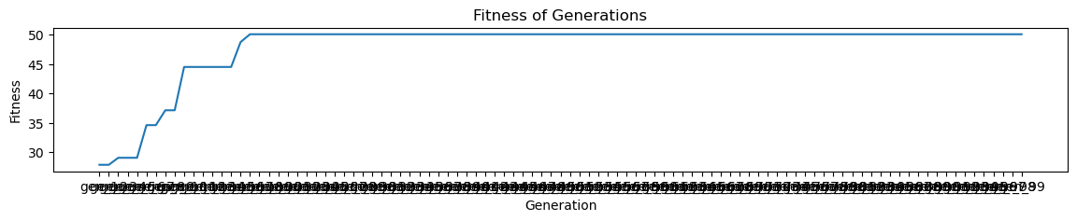
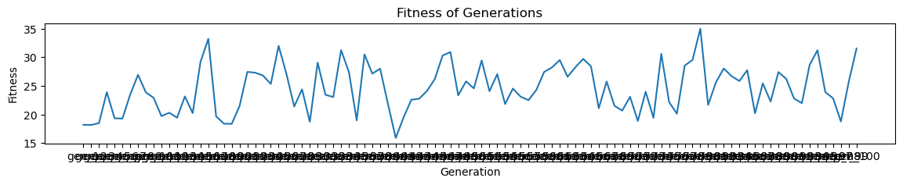
6.1 Exp1 – 100 gen
AEVoT
Best Fitness
Average Fitness

Slide 21
6.2 Exp1 – 100 gen
AEVoT
Kernel size = 16
Board size = 64
Mutation rate = 0.02
Population size = 10
Generation = 100
Elites = 1
Every 10th frame fitness
Alive cell threshold 0.5
AE bottleneck = 36
100th gen elite

Slide 22
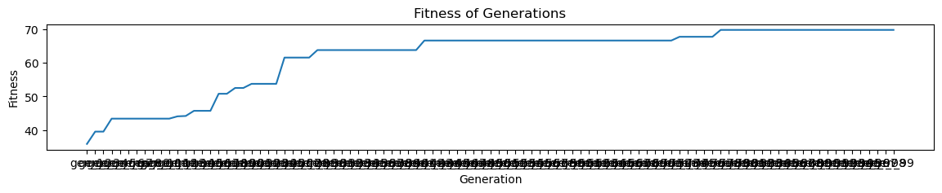
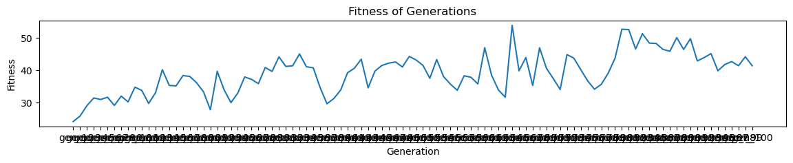
7.1 Exp2 – 100 gen
AEVoT
Best Fitness
Average Fitness

Slide 23
7.2 Exp2 – 100 gen
AEVoT
Kernel size = 16
Board size = 64
Mutation rate = 0.02
Population size = 10
Generation = 100
Elites = 1
Every 10th frame fitness
Alive cell threshold 0.5
AE bottleneck = 36
100th gen elite

Slide 24
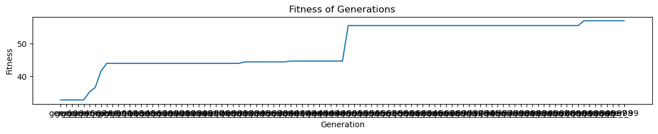
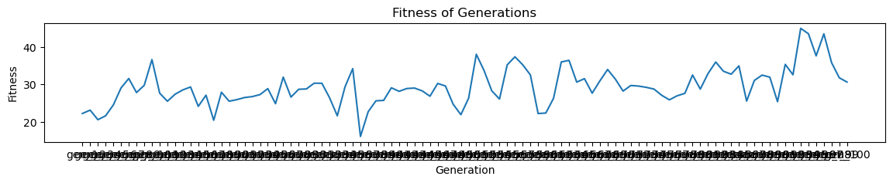
7.1 Exp2 – 100 gen
8.1 Exp3 – 100 gen
AEVoT
Best Fitness
Average Fitness

Slide 25
7.1 Exp2 – 100 gen
8.2 Exp3 – 100 gen
AEVoT
Kernel size = 16
Board size = 64
Mutation rate = 0.02
Population size = 10
Generation = 100
Elites = 1
Every 10th frame fitness
Alive cell threshold 0.5
AE bottleneck = 36
100th gen elite

Slide 26
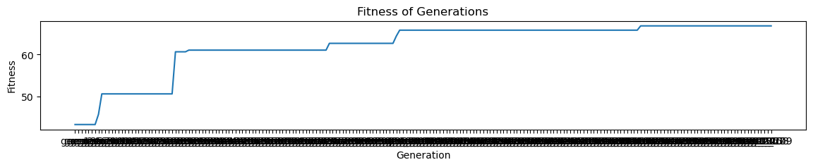
7.1 Exp2 – 100 gen
9.1 Exp8 – 210 gen
AEVoT
Best Fitness

Slide 27
7.1 Exp2 – 100 gen
9.2 Exp8 – 210 gen
AEVoT
Kernel size = 16
Board size = 64
Mutation rate = 0.02
Population size = 10
Generation = 210
Elites = 1
Every 10th frame fitness
Alive cell threshold 0.5
AE bottleneck = 36
210th gen elite

Slide 28
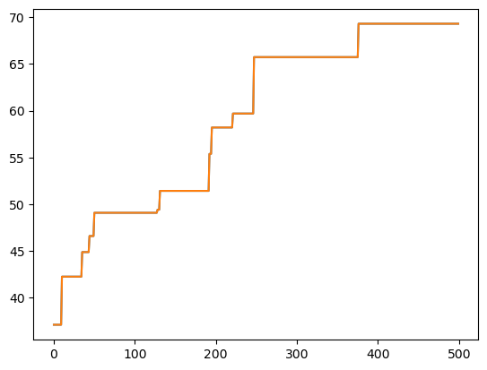
10.1 Exp10 – 500 gen
AEVoT
Best Fitness

Slide 29
7.1 Ex2 – 100 gen
10.2 Exp10 – 500 gen
AEVoT
Kernel size = 16
Board size = 64
Mutation rate = 0.02
Population size = 10
Generation = 500
Elites = 1
Every 10th frame fitness
Alive cell threshold 0.5
500th gen elite

Slide 30
All elites combined with some other EC runs

Slide 31
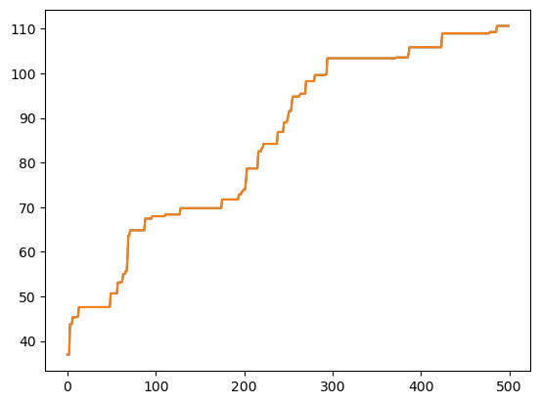
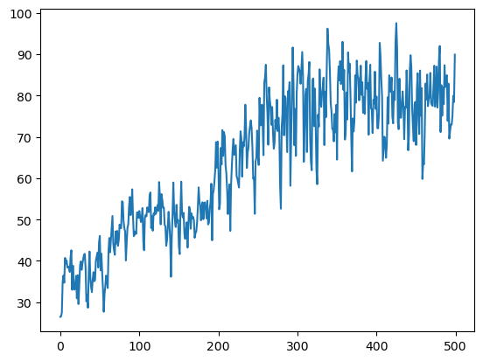
2AE_VOT_P10_G500_M0.02_ALIVE_CELL_THRESHOLD0.1_EVERY_10TH_FRAMES
Elite 499th gen
BEST
kernel_size = 16
board_size = 64
mutation_rate = 0.02
population_size = 10
generation = 500
no_of_elites = 1
AE bottleneck = 36
Every 10th frame
Active cell thresh = 0.1
Average

